Slide 1
Convention 101
Presented by:
Student Nurses’ Association of PA
Board of Directors

Slide 2
What is the Student Nurses Association of PA (SNAP)?
Nonprofit student run organization
Represents over 5,000 nursing students in PA
One of the largest state constituents of the National Student Nurses’ Association (NSNA)
Largest House of Delegates at the 2017 national convention
Recipient of multiple NSNA’s awards including:
Winner's Way Membership Contest awards
Ethics & governance state award for the David R. Ranck LEAD workshop.
Most outstanding state newsletter
Notes:
Winner’s Way is a membership recruitment award offered by NSNA for increased membership

Slide 3
Membership Benefits
Leadership opportunities
Exam preparation courses
Scholarships
Career information
Publication discounts
Legislative representation
Quarterly association newsletter
Annual convention

Slide 4
What is convention?
Convention provides:
Exceptional speakers to inform you of the latest trends, issues, and career opportunities in nursing
Learning opportunities about prominent nursing issues
Leadership opportunities
Participation in the House of Delegates
Networking with hundreds of nursing students from around the state
The chance to meet many prospective employers in the Exhibit Hall

Slide 5
What will I see at convention?
Registration | SCORE! NCLEX challenge bowl
Business Meetings | House of Delegates
Resolutions | Keynote Speaker
Workshops | Exhibit Hall
Awards Celebration | Elections / Voting

Slide 6
Registration
Pre-registration
Done prior to arrival at convention
Cost:
NSNA members: $45
Non-NSNA members: $65
Upon check in, receive your name badge and a complementary tote

Slide 7
Registration (cont.)
On-site Registration
Done upon arrival at convention
Must pay at time of check in. CASH OR CHECK ONLY
Cost:
NSNA members: $55
Non-NSNA Members: $75
Upon check in, receive a complementary tote (if available)

Slide 8
SCORE! NCLEX CHALLENGE BOWL
Quiz bowl sponsored by SCORE!
Teams selected on a first come first served basis
5 team members plus 1 alternate per school
Winning team receives championship silver bowl
Questions will cover all areas of the nursing curriculum
Rules can be found by visiting www.snap-online.org
To register team email snap@snap-online.org

Slide 9
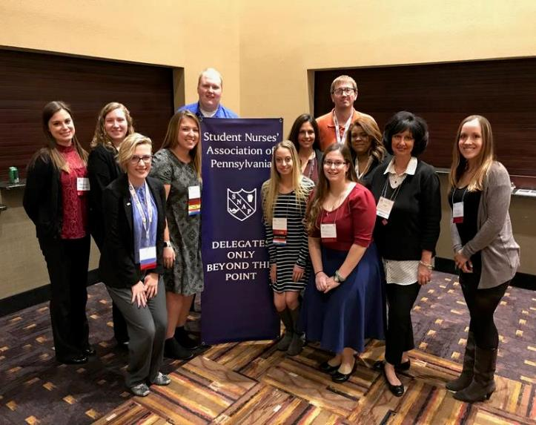
Business Meetings
Conduct association business
Elections
Resolutions
Bylaws amendments
Other business pertinent to the Association
Business attire required
HOUSE OF DELEGATES
Roberts Rules

Slide 10
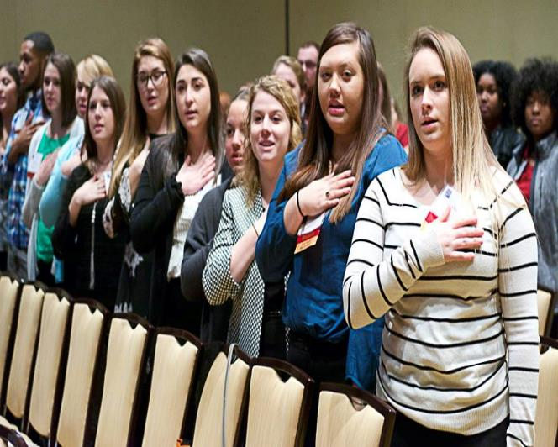
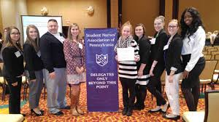
House of Delegates

Slide 11
What is the House of Delegates?
A delegate is a representative from a nursing school in PA
The number of potential delegates are chosen based on the number of NSNA members at the school on October 15th
Each school chooses who their respective delegates will be
Voting on association business, elections, and resolutions occurs during the House of Delegates
Roberts Rules of Order
Parliamentary procedure for deliberation based on consideration of the rights of all members.
Members of the house have the right to make motions, speak, and vote.

Slide 12
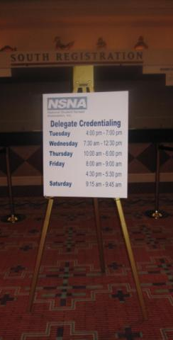
Delegate Credentialing
A delegate must proceed to the delegate credentialing table to register and receive a delegate ribbon
This delegate ribbon allows the individual to sit in the House of Delegates and vote

Slide 13
Resolutions
Research an issue you are passionate about. One that is important to SNAP membership, the nursing profession, and the health needs of our communities
Written statement that, when adopted by the House of Delegates, is the basis for the policies and actions of SNAP
Adopted resolutions propose the stance and actions SNAP will take
You can find more information at https://www.snap-online.org/resources/resolutions/

Slide 14
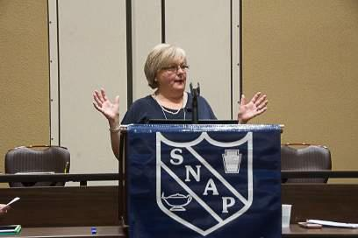
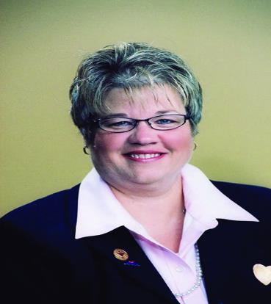
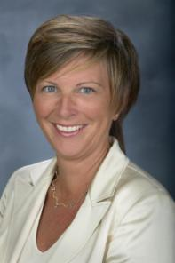
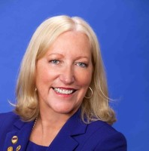
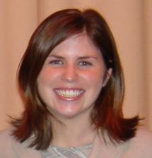
Past Keynote Speakers
Sandra Gomberg, MSN, RN
Rebecca M. Patton, MSN, RN, CNOR, FAAN
Patty Knecht, PhD, MSN
Stephanie Ferguson, PhD, RN, FAAN
AnnMarie Papa, DNP, RN
Jenny Yost, PhD, RN

Slide 15
Workshops
Informative speakers on the latest trends, issues, and career opportunities in nursing. Past topics include:
Finding the courage to lead: Conquering challenges to reap rewards.
Diversity in the nursing workforce & why it matters.
Flight nurse/military nursing
High risk OB nursing
From bedside to boardroom
Pediatric oncology
Psychiatric nursing
Breaking the bullying cycle

Slide 16
Exhibit Hall
50 to 75 vendors, hospitals, and nursing programs present a table on their program
Opportunity to network with your next employer, college, NCLEX prep course
Drawing occurs at the close of Exhibit Hall of prizes donated by exhibitors
Past exhibitors include
Einstein Healthcare Network
Geisinger Health System
Uworld
UPMC Pinnacle Health
Mayo Clinic
Lehigh Valley Health Network
Drexel University online
Fox Chase Cancer Center
PA Department of Corrections
Pennsylvania State Nursing Association

Slide 17
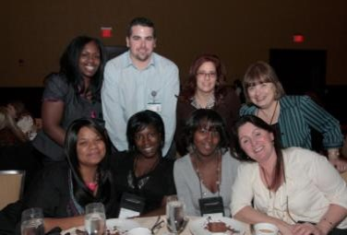
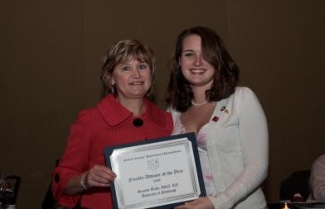
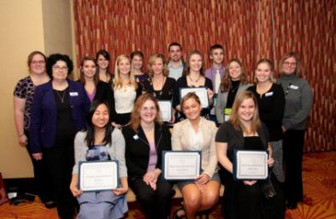
SNAP AWARDS CELEBRATION
Celebration recognizes outstanding members, chapters, and advisors
Ticket price:
Members: $15
Snap alumni, faculty, deans, directors, and guests: $20
Must be purchased with registration and is first come first served

Slide 18
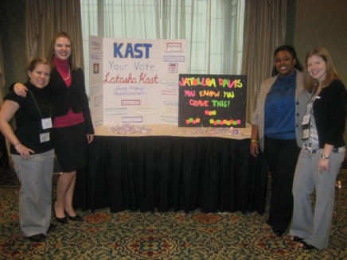
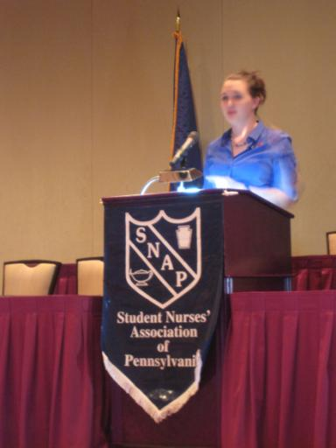
Running For Office
Elected Positions on SNAP board of directors
President
Vice President
Secretary/Treasurer
Legislative coordinator
Regional Coordinators (7 regions)
Nominations and elections committee (NEC)
Complete a Consent to Serve Form
Give a 2 minute speech and post board to place in campaign headquarters
Meet convention delegates and attendees at ‘Meet the Candidates’
Meeting are held in Harrisburg
For more information on the election process, campaign rules and regulations please contact snap@snap-online to be forwarded to the NEC in your region.

Slide 19
STUDENT NURSES’ ASSOCIATION OF PENNSYLVANIA (SNAP)
P.O. Box 6567
Harrisburg, PA 17112
Phone: 717-671-7110
Email: snap@snap-online.org
Visit: www.snap-online.org
The Association of Tomorrow’s Nursing Leaders

