Slide 1
Convention 101
Presented by:
Student Nurses Association of PA
Board of Directors

Slide 2
What is the Student Nurses Association of PA (SNAP)?
Student run organization that represents over 5,000 nursing students in PA
Part of the National Student Nurses' Association
One of the largest state constituents of NSNA
Recipient of multiple NSNA's Winner's Way Membership Contest awards
Notes:
Winner’s Way is a membership recruitment award offered by NSNA for increased membership

Slide 3
Membership Benefits
Leadership opportunities
Exam preparation courses
Scholarships
Career information
Publication discounts
Legislative representation
Quarterly association newsletter
Annual convention

Slide 4
What is convention?
Convention provides:
Exceptional speakers to inform you of the latest trends, issues, and career opportunities in nursing
Learning opportunities about prominent nursing issues
Opportunities for leadership development
Participation in the House of Delegates
Networking with hundreds of nursing students from around the state
The chance to meet many prospective employers in the Exhibit Hall

Slide 5
What will I see at convention?
Registration
Nurse Challenge Bowl
Business Meetings
House of Delegates
Resolutions
Keynote Speaker
Workshops
Exhibit Hall
Awards Banquet
Running for State Office
Elections
Voting

Slide 6
Registration
Pre-registration
Done prior to arrival at convention
Cost:
NSNA members: $40
Non-NSNA members: $60
Upon check in, receive your name badge and a complementary tote

Slide 7
Registration (cont.)
On-site Registration
Done upon arrival at convention
Must pay at time of check in
Costs:
NSNA members: $50
Non-NSNA Members: $70
Upon check in, receive a complementary tote (if available)

Slide 8
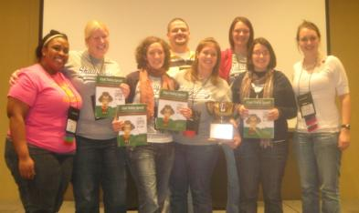
Nurse Challenge Bowl
Quiz bowl sponsored by SCORE!
Questions will cover all areas of the nursing curriculum
5 team members plus 1 alternate per school
Winning team receives trophy
Rules can be found on the SNAP website

Slide 9
Business Meetings
Conduct association business
Elections
Resolutions
Bylaws amendments
Other business pertinent to the Association
Participation by House of Delegates
Business attire required

Slide 10
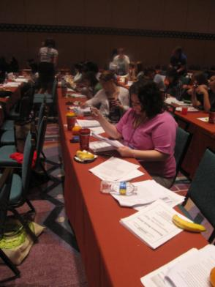
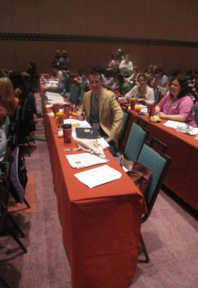
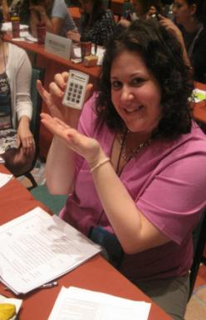
House of Delegates

Slide 11
What is the House of Delegates?
A delegate is a representative from a nursing school in PA
The number of potential delegates are chosen based on the number of NSNA members at the school on October 15th
Each school chooses who their respective delegates will be
Voting on association business, elections, and resolutions occurs during the House of Delegates

Slide 12
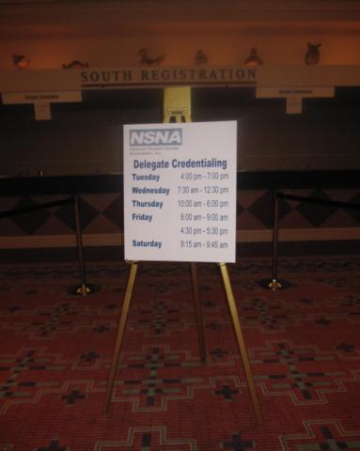
Delegate Credentialing
A delegate must proceed to the delegate credentialing table to register and receive a delegate ribbon
This delegate ribbon allows the individual to sit in the House of Delegates and vote

Slide 13
Resolutions
Written statement that, when adopted by the House of Delegates, is the basis for the policies and actions of SNAP
Includes scholarly quotes taken from literature to describe the topic’s importance
Explains the stance and actions SNAP will take if passed

Slide 14
Resolutions (cont.)
A great way to express something you are:
Concerned about
Passionate about
Feel is important to members of SNAP, the nursing profession, or the health needs of the public
Anyone can write a resolution (only one resolution per chapter)
For more information, please see the Resolution Handbook found on the SNAP website

Slide 15
Previous Resolution Topics
In support of policy development and increased funding for research on lateral violence in nursing
In support of cleaning stethoscopes between patients
In support of increased education on the hazard of extended call light wait times for clients at risk for falling
In support of increased awareness of bone marrow donation and donor registration

Slide 16
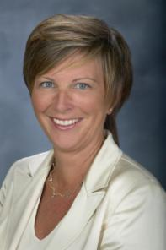
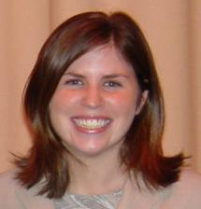
Keynote Speaker
Patty Knecht Keynote 2008
An exceptional leader in the nursing profession who exemplifies the theme of convention
This speaker actively engages and inspires the audience
Dr. Stephanie Ferguson
Keynote 2009
Dr. Jenny Yost
Keynote 2010

Slide 17
Workshops
Informative speakers on the latest trends, issues, and career opportunities in nursing
Provide opportunities to discover new medical applications, hone workplace and personal skills, and hear the latest projections about the future of the field

Slide 18
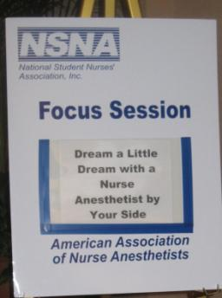
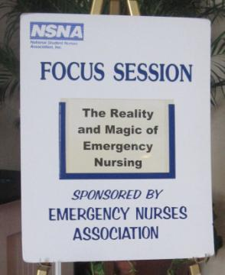
Previous Workshops
What Disney and Nursing Have in Common
Cardiac Induced Hypothermia
Animal Assisted Therapy
Alternative Medicine in Nursing
Nursing Volunteering Opportunities Abroad

Slide 19
Exhibit Hall
50 to 75 vendors, hospitals, and nursing programs present a table on their program
Offer free incentives, such as pens, highlighters, and stress balls
Drawing occurs at the close of Exhibit Hall of prizes donated by exhibitors

Slide 20
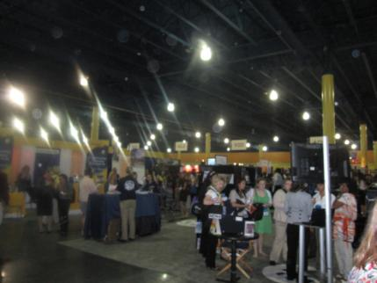
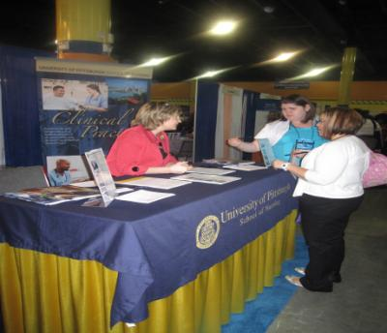
Exhibit Hall (cont.)

Slide 21
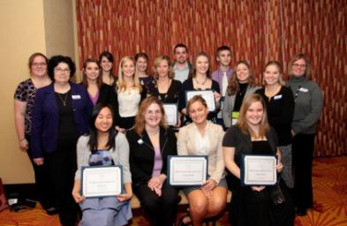
Awards Banquet
Recognizes scholarship and award recipients
Ticket price:
Members: $25
Available with pre-registration only

Slide 22
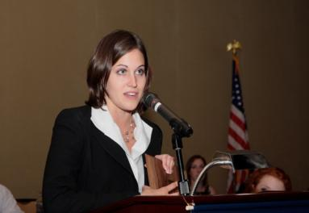
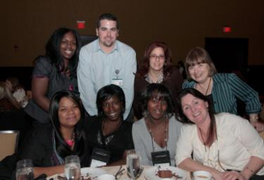
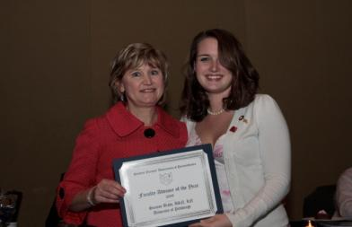
Awards Banquet (cont.)

Slide 23
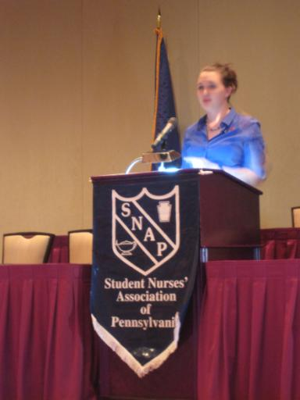
Running For Office
Complete a Consent to Serve Form
Give a 2 minute speech
Meet convention delegates and attendees at ‘Meet the Candidates’
For more information, please contact the Nominations and Elections Committee

Slide 24
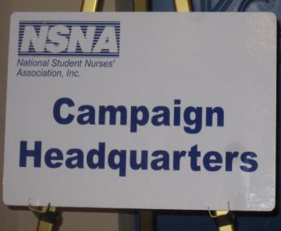
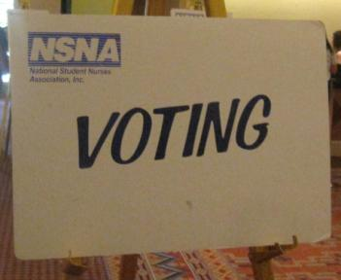
Running for State Office

Slide 25
Top 5 Reasons to Attend SNAP Convention
1. Become more involved with a professional student nurse association
2. Attend exciting social events
3. Explore opportunities for leadership development
4. Networking
5. Have fun!

Slide 26
Questions? Contact snap@snap-online.org or Visit www.snap-online.org

