Slide 1
Chapter Resource Guide created by:
Student Nurses’ Association of Pennsylvania

Slide 2
Table of Contents
How to Start a Chapter
Ideas to Keep Your Chapter Active
Award Opportunities
Legislative Opportunities
Professional Development Opportunities
Helpful Resources

Slide 3
How to Start a Chapter

Slide 4
Five Simple Steps
Gather 1-10 or more students who desire to start a chapter
Submit constituency forms to NSNA (for chapters with 10+ members)
Seek out a faculty advisor
Review SNAP and NSNA websites for guidelines and ideas
Contact a SNAP board member for assistance

Slide 5
Membership
First, determine how many students in your school would be interested in joining your school’s student nursing chapter.
You need a minimum of 10 members for NSNA constituency status. You need only 1 member for SNAP delegate status.
Constituency status is a form submitted to NSNA to verify a school chapter in a state approved program preparing students for licensure as registered nurses has the minimum number of NSNA members
Notes:
NSNA- National Student Nurses’ Association
- For more information, visit www.nsna.org

Slide 6
Submitting Your Membership Forms
Membership forms can be found on the NSNA website.
Go to www.nsna.org and click on Member Services and follow the instructions for online membership registration.
If there is a lot of interest in your school you may want to consider a Total School Membership Plan
Membership cards will be issued once dues and membership forms are received. You can expect to receive your cards within 4 to 6 weeks.

Slide 7
Total School Enrollment
Membership plan where all students in a nursing program are actively involved in the student association
A $10 discount on renewing membership is applied for students in total school enrollment
Allows for increased representation at SNAP and NSNA conventions
For more information, visit http://www.nsna.org/Membership/RecruitmentTools/TotalSchoolMembership.aspx

Slide 8
Dues for Pennsylvania
New Member- $40
Renewals- $45
Two Years- $80
Schools have the option to charge chapter dues
Notes:
Chapter dues are charged in addition to SNAP/NSNA dues.

Slide 9
Faculty Advisor
Designate a faculty member who would be interested in serving as a faculty advisor. Faculty advisors play an important role in advising, promoting professional development and helping to ensure that the chapter runs smoothly.
Faculty advisors can also help assist in creating a budget and applying for funding from your school.

Slide 10
After Membership Forms Are Sent
Elect officers from your student body
Plan meetings and activities

Slide 11
Chapter Elections
Each chapter conducts their own elections from the student body
Board members often are student leaders within the school
For more information, visit http://www.nsna.org/Membership/ChapterToolBox.aspx and http://www.nsna.org/Publications/ChapterResources.aspx

Slide 12
Benefits of Membership
Receive 5 issues each year of Imprint, the NSNA magazine.
Receive Insight, the SNAP digital newsletter
Receive SNAP-To-It, SNAP’s e-newsletter
Discounts on professional
liability insurance, health and
accident insurance through NSNA.
Discounts on several career planning tools and books through NSNA.
Networking
Career Development
Notes:
SNAP- Student Nurses’ Association of Pennsylvania
- For more information, visit www.snap-online.org

Slide 13
Benefits of Membership Cont.
Qualify to apply for NSNA and SNAP scholarships.
Convention which gives you great opportunities to network with other nursing students, hospitals and schools along with all of the other experiences involved with membership in professional nursing organizations
For more information, visit http://www.nsna.org/Portals/0/Skins/NSNA/pdf/4x9%20Membership%20Pamphlet.pdf

Slide 14
NSNA Recruitment Tools
Download the membership recruitment video from NSNA entitled- “Catch the Wave with NSNA”
http://www.nsna.org/Membership/RecruitmentTools/RecruitmentTools.aspx
It is also a good idea to order “Getting the Pieces to Fit”. These can be ordered on www.nsna.org
You could show the video during a designated class time or plan an open house with refreshments to show the video and talk about the benefits of joining a nursing association.
Notes:
“Getting the Pieces to Fit” is a recruitment tool offered by NSNA.

Slide 15
SNAP Regional Coordinators
Regional Coordinators are local contacts between nursing schools and the SNAP Board of Directors
All regional coordinators contact information is listed on the SNAP website at www.snap-online.org
Feel free to contact your regional coordinators with any questions you might have.
They are there to help you with anything you need!

Slide 16
Ideas to Keep Your Chapter Active

Slide 17
Fundraising Ideas
Sweat/Tee- shirt/Tote Bag sale with the name of your School of Nursing (ask for permission to use the name before proceeding)
School of Nursing Blanket sale
Pampered Chef
Stethoscopes / Blood Pressure cuffs sale
Bake sale
Car wash

Slide 18
Fundraising Ideas (Cont.)
Scrub/Nursing Shoes Sales
Book Sale- among students where organization collects a small percent of selling price or sell books donated by faculty members
Raffle- publicize your organization
to local businesses and get donations/gift certificates to raffle at school events
Candy bars- purchase in bulk and sell for twice the price.

Slide 19
Community Service Ideas
Health Fairs on campus, at local schools, or parks
Participating as a group in a walk/marathon
Selling ribbons to donate money
Cook dinner for local cancer patients
Volunteering to educate students on health issues at local schools

Slide 20
Community Service Ideas (Cont.)
Make holiday cards for nursing homes, children’s hospitals, or soldiers overseas.
Educate at Senior Centers about medications, diseases, etc.
Blood Drive
Volunteer at a hospital
Relay for Life
Light the Night Walk
Bone Marrow Drives

Slide 21
Community Service Ideas (Cont.)
Organize events related to observed holidays
For example, blood pressure screening in February (American Heart Month)
For more ideas and a list of observed holidays, visit http://www.nsna.org/Portals/0/Skins/NSNA/pdf/Final%20Draft%20Community%20Health%20Guidelines_2010_%20KGCA.pdf

Slide 22
Social Event Ideas
Holiday Parties
Kick-start finals party
Dessert and Tea socials to kick off new year or welcome new students
Annual Nursing Ball- also could be a fundraiser
Nurses’ Night at a local sporting event- get discount tickets!
Movie Night

Slide 23
Social Event Ideas (Cont.)
Consists of a different event each day, ie: Wear Your Scrubs to Class Day, Faculty Appreciation Ice Cream Social, Battle of the Classes Volleyball Game, Nursing Downtown Party, Movie Night
Nursing Spirit Week

Slide 24
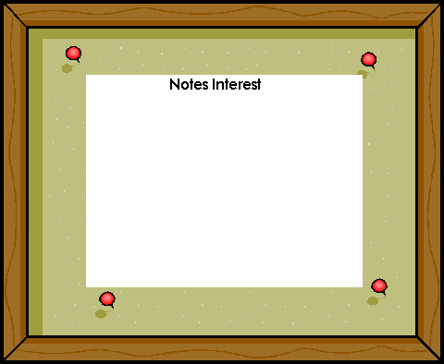
Membership Retention
Maintain a SNAP bulletin board outside classrooms
Newsletters about current events within organization and school of nursing
Peer Advisor Program- Upperclassmen Mentor Program
Develop a chapter website
Student Nurses!

Slide 25
Award Opportunities
All award applications are available on the SNAP website in September for the November convention (www.snap-online.org)

Slide 26
Chapter Excellence Award
Recognition is considered for those chapters who, through hard work and dedication, demonstrate versatility in their progress and activities that ultimately enhance member participation.

Slide 27
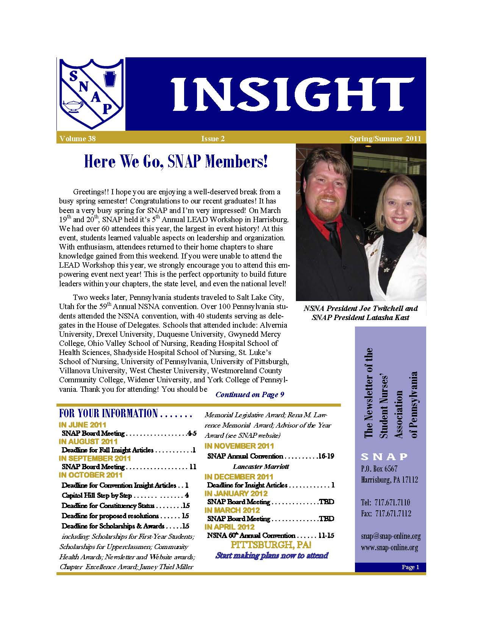
Chapter Newsletter
Judging for this award includes content, layout, and accuracy of each chapter’s newsletter while promoting students participation, inspiring student contributions, and upholding the image of nursing.
(NSNA Newsletter)
(SNAP Newsletter)

Slide 28
Website Award
Criteria include frequency of updates, design and layout, links, and ease of application.

Slide 29
Community Health Award
This award is given in recognition of the community based projects that a local chapter participates in. These projects aim to educate health care consumers about illness prevention, early detection of disease and treatment options, while creating awareness about changes in community health."

Slide 30
Jamey Thiel Miller Award
In honor of Jamey, what she contributed to SNAP, and to the nursing profession, this award will be given to the individual or group who demonstrates an effort in political involvement that will increase nursing student awareness.

Slide 31
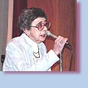
Dr. Rena Lawrence Memorial Award
This award was established in memory of Dr. Rena Lawrence, one of Pennsylvania’s brightest nursing leaders. It will be presented to a distinguished nursing student who excels in all the following aspects of nursing: academics, personal and professional growth, leadership and citizenship.

Slide 32
SNAP Advisor of the Year Award
When motivation , enthusiasm, professionalism, and education from a faculty advisor encourage and inspire you, take the time to nominate them for this distinguished honor.

Slide 33
Scholarship Application
Scholarships are available to SNAP/NSNA members with active nursing student organization involvement at the local, state, and national level. An essay and letter of recommendation are required.

Slide 34
Legislative Opportunities

Slide 35
Capitol Hill Step by Step
This day spent on our Capitol Hill in Harrisburg, PA is an on-site learning experience for your chapter about how legislation is carried out and why and how legislation impacts nurses.

Slide 36
Capitol Hill: Step by Step (Cont.)
Free program encouraging students to get excited about the political process
Held once each year, in the spring
Attendees will have opportunities to hear from speakers, plan a meeting with your local legislators, and tour the beautiful, historic Capitol Building
For more information, visit http://snap-online.org/programs/capitol-hill-step-by-step/

Slide 37
Writing A Resolution
A resolution is a written statement that, if passed/adopted by the House of Delegates, establishes the basis for the policies and actions of the Student Nurse Association of Pennsylvania
Any member of the organization may author and submit a resolution (only one resolution per chapter)

Slide 38
Resolution Topics
Important issues in healthcare that the author feels the organization (SNAP) needs to recognize as significant for student nurses
Examples: Blood pressure screening, cultural competency, and cardiac induced hypothermia
For more information, visit http://snap-online.org/resources/resolutions/
Please contact the SNAP Legislative Coordinator for assistance:
legislativecoordinator@snap-online.org

Slide 39
Resolution Process
Once passed, resolutions are sent to other relevant professional organizations and are placed in the policy manual.
If feasible, resolutions passed will be used for future topics in newsletter articles and convention workshops.
This is an excellent opportunity to not only be an active participant at convention but also for members to showcase interesting issues about which they are learning and researching.

Slide 40
Resolutions: Why Should You Write One?
Bring attention to a cause/concern impacting the health of individuals and communities.
Determine the position of SNAP regarding resolutions adopted during the House of Delegates during the Annual SNAP Convention.
Make an impact on the future of health care

Slide 41
Professional Development Opportunities

Slide 42
LEAD Workshop
Designed for emerging leaders from Pennsylvania's local chapters to gain leadership and development skills
Ideally, participants will be freshmen and sophomores
Topics include bylaws, utilizing your faculty advisor, fundraising, and chapter development.
For more information, visit http://snap-online.org/programs/lead-workshop/

Slide 43
SNAP Convention
Convention provides:
Exceptional speakers to inform you of the latest trends, issues, and career opportunities in nursing
Learning opportunities about prominent nursing issues
Opportunities for leadership development, run for SNAP office, contact your Nominations and Elections Committee (NEC) representative
Participation in the House of Delegates
Networking with hundreds of nursing students from around the state
The chance to meet many prospective employers in the Exhibit Hall
Increase professionalism and knowledge
For more information, visit http://snap-online.org/convention/snap-annual-convention/studentsalumnifaculty/

Slide 44
Helpful Resources

Slide 45
NSNA Resources
www.nsna.org
National Student Nurses Association Website
http://www.nsna.org/Portals/0/Skins/NSNA/pdf/2010%20NSNA%20Annual%20Membership%20Powerpoint.pdf
More Information on NSNA
http://www.nsna.org/Portals/0/Skins/NSNA/pdf/Final%20Draft%20Community%20Health%20Guidelines_2010_%20KGCA.pdf
Guidelines for Community Health Projects

Slide 46
NSNA Resources (Cont.)
http://www.nsna.org/Publications/ChapterResources.aspx
Chapter Development Resource
http://www.nsna.org/Membership/ChapterToolBox.aspx
Membership Resource
http://www.nsna.org/Publications/GettingthePiecestoFit.aspx
Membership Resource

Slide 47
Good Luck Chapters!!!
Feel free to contact the SNAP Board of Directors and/or check out our website at
www.snap-online.org
Notes:
You may also email snap@snap-online.org with any questions!!

